Slide 1
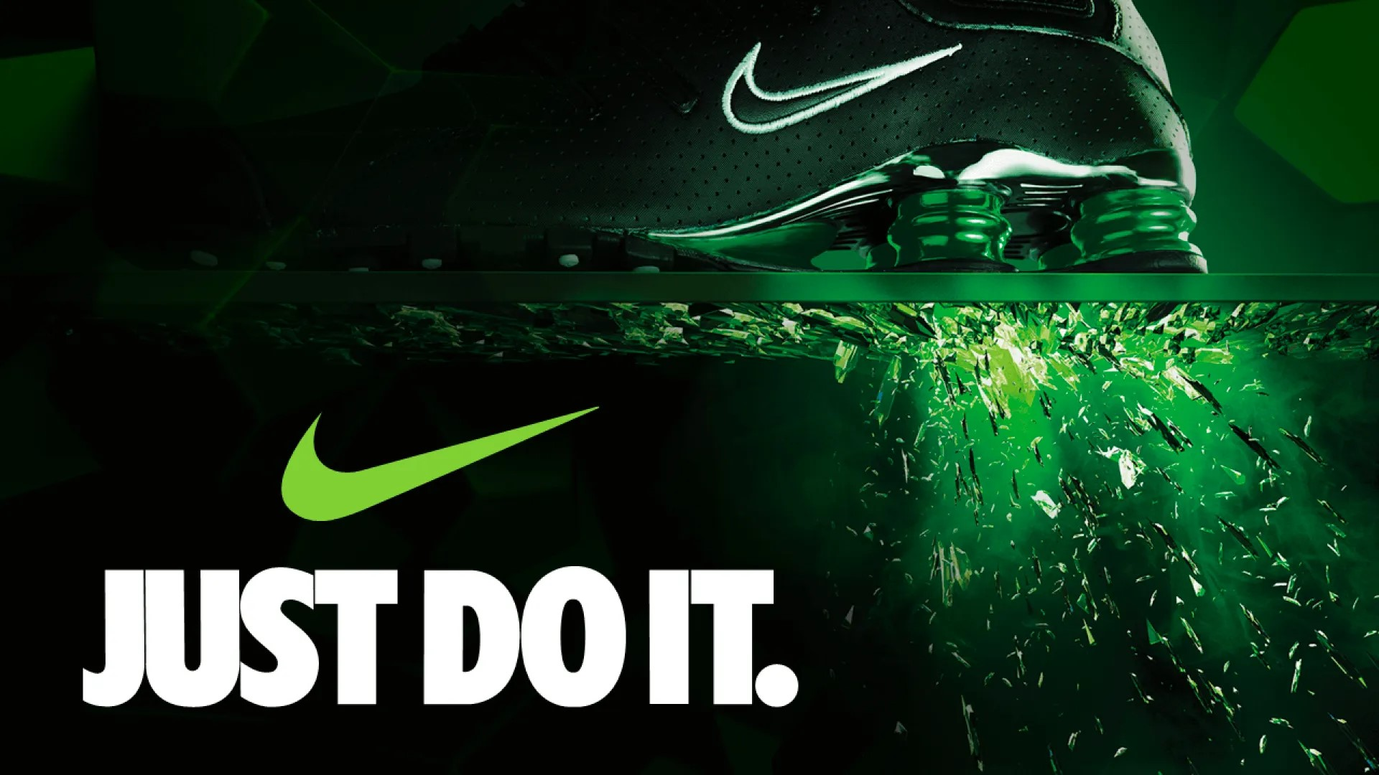
HOW NIKE DROPPED THE BALL?​

Slide 2
Executive Summary
The global footwear industry faces affordability challenges, tech inefficiencies, sustainability concerns, and geopolitical risks impacting innovation, operations, and pricing.
The industry faces dynamic challenges and opportunities shaped by changes in consumer behavior, counterfeits, sustainability, and innovation, demanding strategic agility and consumer-centric solutions.
Incumbents focus on innovation, affordability, and market expansion, insurgents focus on disruptive innovation, while adjacents explore new markets, materials, distribution and technology integrations to enhance product offerings.
Nike tackles its D2C failure, counterfeits, and competition by leveraging AI, 3D printing, sustainable practices, strategic marketing and innovation to regain sneaker dominance and its lost loyalty.
Nike’s strategy focuses on optimizing supply chains, innovating through AI and technology, revolutionizing sustainability, and personalizing consumer experiences across three strategic horizons.

Slide 3
The global footwear industry faces affordability challenges, tech inefficiencies, sustainability concerns, and geopolitical risks impacting innovation, operations, and pricing.
S
T
E
E
P
SOCIETAL
TECHNOLOGICAL
ECONOMICAL
ENVIRONMENTAL
POLITICAL
High inflation has led 69% of US consumers to reduce nonessential spending, with many opting for footwear at discounted prices.
With 32% of global apparel and footwear sales occurring online, brands face challenges in managing high return rates due to fit and comfort issues.
While some mainstream brands like Nike and Jordan experienced declines (Nike down 11% and Jordan down 12% year-over-year), brands like Asics grew by 589%, showing a shift in consumer preference towards emerging brands and styles.
The average time to bring a new shoe to market is still around 200 days, which raises uncertainty about whether technological advancements will significantly reduce this timeline and enhance responsiveness to market trends.
Approximately 70% of organizations struggle with integrating new technologies into their existing operations, leading to inefficiencies and uncertainty in achieving streamlined processes.
By the end of 2023, the counterfeit sneaker market was valued near $600 billion, about 1.5 times greater than the legitimate footwear industry.
The cost of metals used in sportswear production increased by 88%, while cotton, fibers, and rubber prices also rose significantly
Global footwear production dropped by 6% to 22.4 billion pairs in 2023, the lowest in a decade excluding pandemic years.
58% of consumers care about the materials that make their clothes and want them to not be harmful to the planet.
Only about 5% of shoes are recycled, with the majority ending up in landfills. Most shoes contain up to 40 different materials, many of which are difficult to recycle or biodegrade.
The footwear industry contributes 1.4% of global greenhouse gas emissions, nearly matching the aviation industry. Production of a single pair of running shoes equates to running a 100-watt light bulb for a week.
With 60% of global footwear production depending on China and Vietnam, which are politically unstable and the consequent geopolitical tension would significantly increase tariff rates, potentially increasing footwear prices by 18% to 29%.
For industries with strict standards, such as footwear manufacturing, qualifying and certifying 3D printed parts is challenging. Around 50% of companies report that navigating these regulatory requirements is a major barrier to adoption.

Slide 4
The industry faces dynamic challenges and opportunities shaped by change in consumer behavior, counterfeits, sustainability, and innovation, demanding strategic agility and consumer-centric solutions.
Counterfeits decreases
Sneaker Deluxe
With strong regulation against counterfeits, consumers have no other option but to buy authentic footwear. Brand value increases but prices also increase significantly. Industry focuses on premium positioning by emphasizing authenticity, quality and innovation to justify higher costs.
Innovation Mania
Brands intensify innovation efforts as consumers prioritize performance and brand value perception. As the industry value grows, all companies invest heavily in R&D. This leads to healthy competition and the company pioneering in quality, innovation and marketing wins.
Consumer spending Decreases
CONSUMER PURCHASING
POWER FOR FOOTWEAR
Consumer spending Increases
COUNTERFEIT PRODUCTION
Fake Paradise & Upstarts
Footwear is very expensive and consumers heavily rely on counterfeit footwear and upstarts who are innovating rapidly and offer footwear at cheaper prices. Expensive sneaker lines struggle to maintain profitability, loyalty and market share. In the battle between expensive brands, upstarts and risky counterfeits, the latter two wins.
Authentic Dominance
Brands find it difficult to protect their intellectual property, since real footwear is indistinguishable from counterfeits. There is a meager price difference between real and counterfeit footwear, which aids former to win the battle. Brands invest in efforts to make themselves inimitable.
Counterfeit increases
Timeline : 6 years

Slide 5








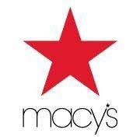
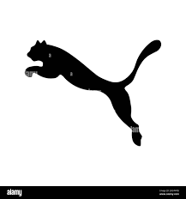




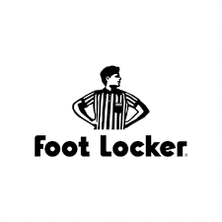





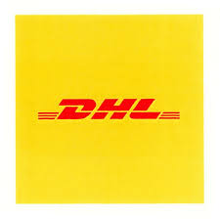

Incumbents focus on innovation, affordability, and market expansion, insurgents focus on disruptive innovation, while adjacents explore new markets, materials, distribution and technology integrations to enhance product offerings.
Counterfeits Decreases
Incumbents innovate, Insurgents differentiate, Adjacents integrate
Incumbents grow, Insurgents go sustainable, Adjacents disrupt
INCUMBENTS | INSURGENTS | ADJACENTS
Nike: Focus on radical innovations and eliminating D2C model.. Adidas: Integrate cutting edge tech in shoes. On: Provide high comfort footwear at comparatively affordable pricing. | Handsfree Labs: Innovate hands-free technology for footwear. Movmenta: Integrate smart sensors into footwear. Patagonia: Increase its appeals to eco-conscious consumers. | Google: Develop AR solutions for virtual try-ons. Whoop: Integrated into premium footwear to provide detailed analytics. Macy's: Help big brands sell outdated shoes effectively.
INCUMBENTS | INSURGENTS | ADJACENTS
Nike: Hybrid model of creating exclusivity while setting innovation benchmarks. Adidas: Focus on innovation and expand into emerging markets. Puma: Lead emerging markets, increase affordability, optimize manufacturing capabilities. | Allbirds: Leverage their reputation for sustainability and innovation in materials. Hoka One One: Invest in R&D, leveraging their niche expertise. Rothy’s: Scale and innovate their sustainable, 3D-knitted footwear. | Apple: Integrating wearable technology into shoes Bolt Threads: Partner with footwear companies to provide sustainable materials. Footlocker, Macy's: Increase the reach of brands with extensive distribution channels.
Consumer Spending Decreases
CONSUMER PURCHASING
POWER FOR FOOTWEAR
Consumer Spending Increases
COUNTERFEIT PRODUCTION
Incumbents go cheap, insurgents scale-up, Adjacents support
Incumbents authenticate, Insurgents innovate, Adjacents collaborate
INCUMBENTS | INSURGENTS | ADJACENTS
Hoka One One: Innovate rapidly and build loyalty of performance enthusiasts. On: Continue enhancing comfort and performance. Shoes that feel like walking on a cloud | Counterfeiters: Rapidly expand production, optimize manufacturing, reduce costs and increase the distribution channels across geographies. | Alibaba: Help brands free up inventory by selling at competitive prices. Social Media: A medium used extensively by counterfeiters. PayPal: Enable quick and secure transactions for counterfeit goods.
INCUMBENTS | INSURGENTS | ADJACENTS
Nike: Invest in authentication technologies, reduce pricing and increase legal efforts. Local Factories in Putian: Scale-up counterfeits production. | Balena: Innovate bio-based thermoplastic materials, expand sustainable offerings. Hoka One One: Improve the distinctive design and technology behind their footwear. | DHL and FedEx: Distribute counterfeit goods globally without verifying the authenticity. Local Textile Manufacturers: Provide counterfeiters with replica footwear materials.
Counterfeits Increases
Timeline : 6 years

Slide 6



Nike tackles its D2C failure, counterfeits, and competition by leveraging AI, 3D printing, sustainable practices, strategic marketing and innovation to regain sneaker dominance.
DRIVERS
OPPORUNITIES
THREATS
STRATEGIC RESPONSE
Counterfeit Proliferation
By the end of 2023, the counterfeit sneaker market was valued near $600 billion, about 1.5 times greater than the legitimate footwear industry.
Personalize through D2C ecosystem: . Leverage the data collected through its D2C channels to personalize shopping experiences and organize community building events to revitalize its brand image and experience.
Real-time AI counterfeit security: Leverage its resources to invest in developing cutting edge AI models for multiple purposes such as counterfeit detection, blockchain security and optimizing design to align with consumer preferences.
Scale-up 3D printing: Invest heavily in integrating 3D printing technology into mainstream footwear manufacturing.
Maintain Loyalty: Create loyalty by perception through its premium sneaker lines, community building and innovative, bold marketing strategies.
Indistinguishable Counterfeiting: Proliferation of advanced counterfeit manufacturing operations.
Upstart threats and Fickle Loyalty: Nike’s stagnation in innovation, enabled new entrants like Hoka and On to gain a large market share through disruptive innovation and cheaper footwear, indicating fickle loyalty and changing consumer preferences
.
Reduced hype: Significant deterioration in the perceived exclusivity of premium sneaker lines and consequently the brand image. Consumers’ reluctance to spend lavishly in the resale market dramatically reduces the demand and its exclusivity.
Price conscious Consumers: Inflation driving away price conscious consumers and seek discounted footwear from wholesalers, where Nike does not predominantly exist. Consumers even seek counterfeit footwears.
Focus on developing inimitable authentication innovations that counterfeiters cannot replicate. Integrate those technologies into mass production while concurrently reducing costs.
Quality focused innovation and establish a hybrid model of maintaining D2C channels and collaboration with wholesalers. Eventually, radically innovate its D2C channels.
Invest heavily in integrating 3D printing technology for on-demand personalized production, minimizing inventory needs, reduces waste, and allows for localized production, enhancing the customer experience through customization.
Strengthen sustainability initiatives by increasing the use of eco-friendly materials and promoting transparency in production methods. Nike build loyalty among eco-conscious consumers while addressing competition in sustainable design technologies.
Consumer Purchasing Power
High inflation has led 69% of US consumers to reduce nonessential spending, with many opting for footwear at discounted prices.

Slide 7
Nike’s strategy focuses on optimizing supply chains, innovating through AI and technology, revolutionizing sustainability, and personalizing consumer experiences across three strategic horizons.
NOW
NEXT
NEW
Scale-up 3D printing, automation and sustainability efforts
Hybrid model of D2C channels and wholesalers
Blockchain security meets inimitable design
Create exclusivity and radicalize innovation
Sensors and AI-powered performance tracking footwear
In-store 3D printing kiosks
Launch Nike Family
Value
AI-driven security
Leverage D2C channel data to create disruptive innovations
Gen AI to personalize footwear
Bold marketing campaigns of its commitment and transparency
HORIZON 1
(0-2 years)
HORIZON 2
(2-4 years)
HORIZON 3
(4-6 years)
Time
Improve supply chain efficiency by scaling up Nike’s FlyPrint technology, 3D printing, digitized laser beams and automation, surging the use of environmentally preferred materials to 50% by 2025.
- Develop a hybrid model where Nike efficiently scale-down and optimize their D2C channels while establishing strong relationships with wholesalers to sell its $9.3 billion inventory.
Integrate advanced technology such as Crypto Kickstarters and Digital Locker with enhanced, inimitable product design such as holograms and watermarks, and offering performance benefits that cannot be replicated.
- Reduce premium sneaker line releases and concurrently set dedicated teams at NSLR to shift focus from being just a lifestyle shoe brand revamping old ideas, to radically innovating performance shoes and invest in AI
Create AI driven tools at the NSLR with advanced image recognition and pattern matching, to scan various online platforms, to identify unauthorized use of trademarks and counterfeit products.
With its D2C channels, develop custom generative AI model to optimize operations, create disruptive footwear innovations and importantly build community building experiences based on preferences observed in geographical regions using extensive analytics.
Enhancing its AIR(Athlete Imagined Revolution) initiatives using Gen AI to personalize footwear for partnered athletes and reflect on consumer footwear.
- Develop purpose-driven, bold marketing campaigns, promoting their causes, alongside achievement of sustainability goals and provide transparency in production methods
. Integrate sensors and AI into performance shoes, tracking users’ health metrics, synced with mobile apps to provide real time feedback. Launch the Adapt series for all sports, integrating temperature adjustment, advanced biomechanics, dynamic cushioning and anti-fatigue designs.
Launch in-store 3D printing kiosks, where users can design their shoes using sustainable materials and print footwear locally, circumventing tariffs by shipping raw materials rather than finished products, while personalizing shopping experience.
Launch Nike family, an ecosystem where every shoe has built-in sensors that are integrated with an app, tracking performance on each footwear they own and provide rewards accordingly. The app will also log users’ entire Nike journey, personalizing their Nike experience.
CAPABILITY BUILDING
Accelerate authentication tech, sustainability efforts, create lost exclusivity, create a hybrid model and invest heavily on radical innovation.
Create AI tools to combat counterfeits, develop sustainable product designs, personalize footwear for athletes, and promote transparency in sustainability.
Invest in its D2C channels again by integrating AI and sensors in footwear, launch in-store 3D printing kiosks, and create a personalized ecosystem tracking user performance.

Slide 8
APPENDIX

Slide 9
Counterfeiters sell cheap footwear that is indistinguishable from expensive, branded sneakers, through complex distribution networks. Companies reduce cost, seek sustainability to differentiate and invest in inimitable authentication technologies.
Through tightened security and regulations, counterfeits decrease. This increases the industry value, helping companies invest heavily in R&D while leading to healthy competition.
Counterfeit Production Increased
Counterfeit Production
Counterfeit Production Decreased
ECONOMIC
Consumers seek for cheaper footwear due to inflated costs. While brands try to reduce the price, they also invest in technology to justify the high price through innovative product offerings.
.
This allows companies to release cheaper product lines, almost similar to counterfeit footwear. This increases the sales and value of companies, since global supply chain eases, thereby enabling companies to optimize production.
Geopolitical tension affecting Tariff rates
High Tariff rates
Low Tariff rates
POLITICAL

Slide 10
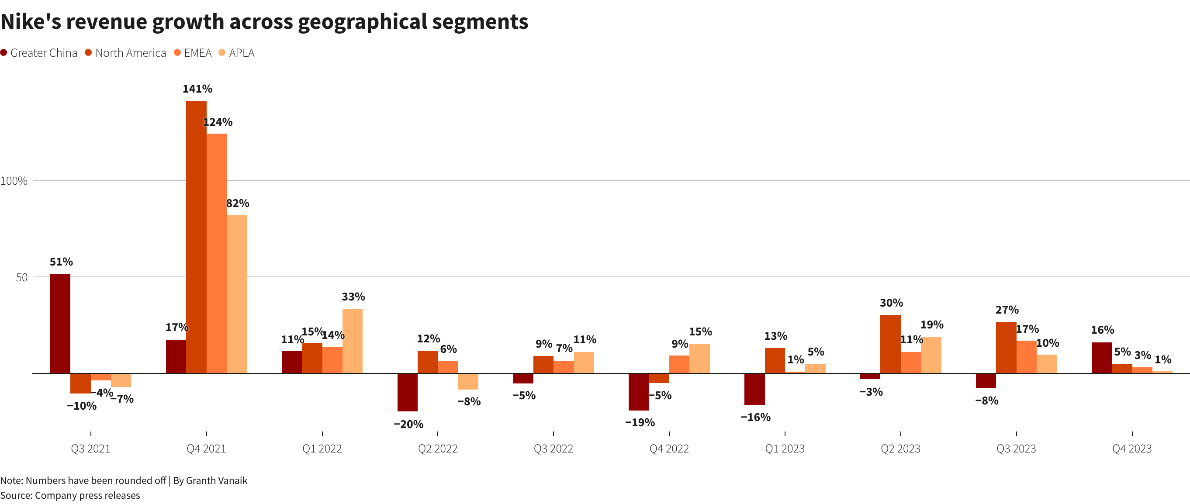
Nike's Annual Revenue (in billions of US dollars):
2024: $51.36
2023: $51.22
2022: $46.71
2021: $44.54
Nike's Quarterly Revenue (in billions of US dollars):
2024-08-31 (Q1 2025): $11.59 (10% decrease year-over-year)
2024-05-31 (Q4 2024): $12.61 (2% decrease year-over-year)
2024-02-29 (Q3 2024): $12.43
2023-11-30 (Q2 2024): $13.39
2023-08-31 (Q1 2024): $12.94Nike Digital Sales:
Q4 2024: 10% decline
Q3 2024: 4% declineNike Direct Revenue:
Q4 2024: $5.1 billion (8% decline)

Slide 11
Year | Legitimate Footwear Industry Value | Counterfeit Footwear Industry Value
2019 | $397.7 billion | $111.4 billion
2020 | $342.0 billion | $450.0 billion
2021 | $346.5 billion | $495.0 billion
2022 | $381.9 billion | $500.0 billion
2023 | $398.5 billion | $599.0 billion
As of 2023, the value of the counterfeit footwear industry is 1.5 times that of the legitimate footwear industry.
The overall counterfeit market is projected to grow to $1.79 trillion by 2030, a 75% increase in just one year.

Slide 12
REFERENCES
https://runrepeat.com/counterfeit-shoes-statistics
https://www.just-style.com/features/explainer-true-cost-for-apparel-footwear-sectors-in-trumps-america/
https://www.3dnatives.com/en/nike-air-revolutionizing-shoes-with-3d-printing-160420246/
https://www.samford.edu/sports-analytics/fans/2019/Nike-Caught-in-the-Crosshairs-of-the-Trade-War
https://www.retaildive.com/news/nike-converse-sue-counterfeiting-networks/719318/
https://brainstation.io/magazine/nike-cryptokicks-concept-battles-counterfeits-with-blockchain
https://www.slidegenius.com/portfolio/nike
https://simba-digital.ch/en/nikes-marketing-strategy-that-revolutionized-the-sports-industry/
https://about.nike.com/en/newsroom/releases/nike-ignites-new-frontier-of-innovation-with-40-elite-athletes-in-unforgettable-experience-in-paris?t&utm_source=perplexity
https://aimresearch.co/ai-in-cpg-retail/how-nike-is-using-ai-to-transform-product-design-customer-experience-and-operational-efficiency
https://www.investopedia.com/articles/markets/080415/how-nike-nke-makes-its-money.asp
https://consumergoods.com/nike-sports-research-lab-expedites-product-innovation-ai-and-4d-motion-capture
https://www.reuters.com/business/retail-consumer/nike-beats-quarterly-revenue-estimates-buoyant-sneaker-demand-2023-06-29/

